Slide 1
PREDICTIVE
MAINTENANCE
ENGINEERING EDUCATION
From Sensor Data to Safer, Smarter Maintenance — An Engineering Student's Guide

Slide 2

THE MAINTENANCE PROBLEM
Why Maintenance Strategy Matters
Unplanned equipment failures cost industrial facilities billions annually. Unexpected breakdowns halt production lines, causing cascading delays and missed delivery targets. Beyond lost output, sudden failures expose workers to serious safety hazards — from high-pressure releases to electrical faults. Emergency repairs demand premium labour rates, expedited parts, and extended downtime. As assets age and systems grow more complex, reactive maintenance cycles become unsustainable, driving up costs and eroding competitiveness.

Slide 3

DEFINITION & CORE IDEA
What Is Predictive Maintenance?
Predictive maintenance (PdM) uses real-time condition data — vibration, temperature, pressure, current — combined with analytics to anticipate equipment failures before they occur. Rather than reacting to breakdowns or following fixed schedules, PdM continuously monitors asset health, establishes normal baselines, and triggers intervention only when data signals an emerging fault. The result: the right action, on the right asset, at exactly the right time.

Slide 4
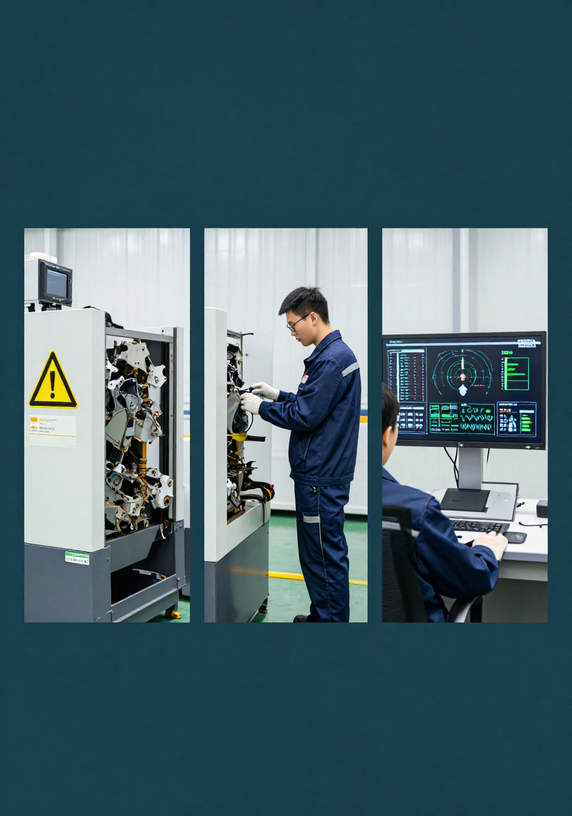
REACTIVE VS PREVENTIVE VS PREDICTIVE
Comparing Maintenance Strategies
Reactive: Fix it after it breaks — low upfront cost, high downtime risk. Preventive: Schedule maintenance by time or usage — reduces failures but wastes resources on healthy assets. Predictive: Monitor real-time condition data to intervene only when needed — maximising uptime, minimising waste, and preventing unplanned failures before they occur.

Slide 5

WHY IT MATTERS
Uptime, Quality, Safety, Cost & Resources
Predictive maintenance delivers measurable value across five dimensions: maximising equipment uptime by catching faults before failure; protecting product quality through consistent process conditions; safeguarding worker safety by preventing catastrophic breakdowns; reducing maintenance costs by eliminating unnecessary interventions; and optimising resource allocation so skilled technicians focus where they are needed most.

Slide 6
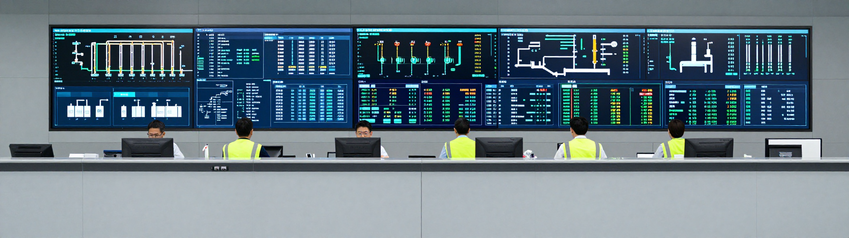
END-TO-END WORKFLOW
From Sensor to Safe Action
The predictive maintenance cycle follows eight linked steps: (1) Sense — transducers capture vibration, temperature, pressure, and current; (2) Collect — edge devices aggregate raw signals; (3) Transmit — data streams to the cloud or on-premise server; (4) Analyze — algorithms extract features and identify patterns; (5) Detect — anomaly models flag deviations from baselines; (6) Decide — severity scoring prioritises alerts; (7) Schedule — work orders are automatically raised in the CMMS; (8) Act & Learn — technicians intervene and outcomes feed back to retrain models.

Slide 7
SENSORS & SIGNALS
TECHNICAL FOUNDATIONS
What Machines Reveal Through Their Signals

Slide 8

SENSORS & SIGNALS
The Eyes and Ears of the Machine
Predictive maintenance begins with data. Key sensor types include vibration accelerometers (detecting imbalance, misalignment, bearing faults), thermocouples and IR sensors (surface and bearing temperatures), pressure transducers (fluid and gas systems), current transformers (motor load and efficiency), acoustic emission sensors (crack propagation, leaks), tachometers (rotational speed), and process context signals (flow rate, torque, load). Each signal type reveals a distinct failure mode, and combining multiple streams dramatically improves diagnostic accuracy.

Slide 9
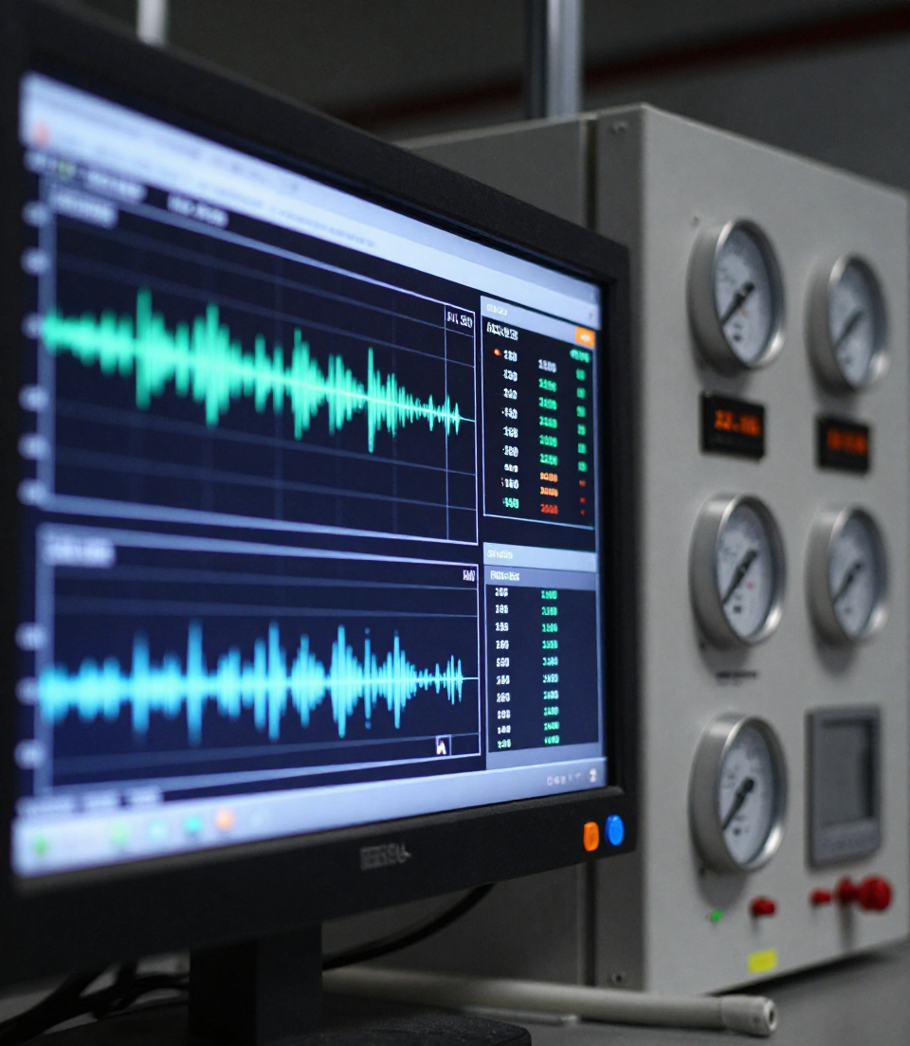
CONDITION MONITORING & BASELINES
Establishing Normal Behavior
Condition monitoring captures continuous sensor data to define an asset's normal operating state. Engineers establish baseline signatures — vibration, temperature, pressure, current — under known healthy conditions. Statistical thresholds and trend bands are then set so that any deviation triggers an alert. Comparing real-time readings against reference signatures reveals emerging faults before failure occurs.

Slide 10
VIBRATION DIAGNOSTICS
SLIDE 10 OF 20
Imbalance · Misalignment · Looseness · Bearing Defects · Frequency Spectra

Slide 11

THERMAL & OTHER DIAGNOSTICS
Broadening the Diagnostic Toolkit
Infrared thermography detects heat anomalies in electrical panels, motors, and bearings before failure. Oil analysis reveals wear particles, contamination, and degradation trends. Ultrasound sensing identifies leaks, arcing, and early-stage friction. Motor current signature analysis (MCSA) uncovers rotor faults and misalignment without physical contact. Visual inspection, augmented by cameras and AI, catches surface cracks, corrosion, and misalignment. Together, these complementary techniques provide a multi-layered view of asset health that no single method can achieve alone.

Slide 12

IOT/EDGE/CLOUD ARCHITECTURE
From Sensor to Decision: The Data Pipeline
Predictive maintenance relies on a layered architecture: sensors capture raw signals at the machine level, edge gateways pre-process and filter data locally to reduce latency and bandwidth, connectivity protocols (MQTT, OPC-UA) transmit data securely, and cloud platforms host advanced analytics, AI models, and historian databases. Dashboards and CMMS systems then deliver actionable alerts to maintenance teams in real time.

Slide 13

AI & ANOMALY DETECTION
Teaching Machines to Recognize Failure Signatures
AI models learn what "normal" looks like by training on historical sensor data. Supervised learning uses labeled fault examples; unsupervised learning flags statistical deviations without prior fault data — ideal for rare failures. Key features (vibration RMS, temperature delta, spectral peaks) feed into models such as autoencoders, isolation forests, or neural networks. When sensor readings drift beyond learned baselines, an alert is triggered. Explainability tools (e.g., SHAP values) highlight which features drove the anomaly, helping engineers trust and act on AI-generated warnings.

Slide 14
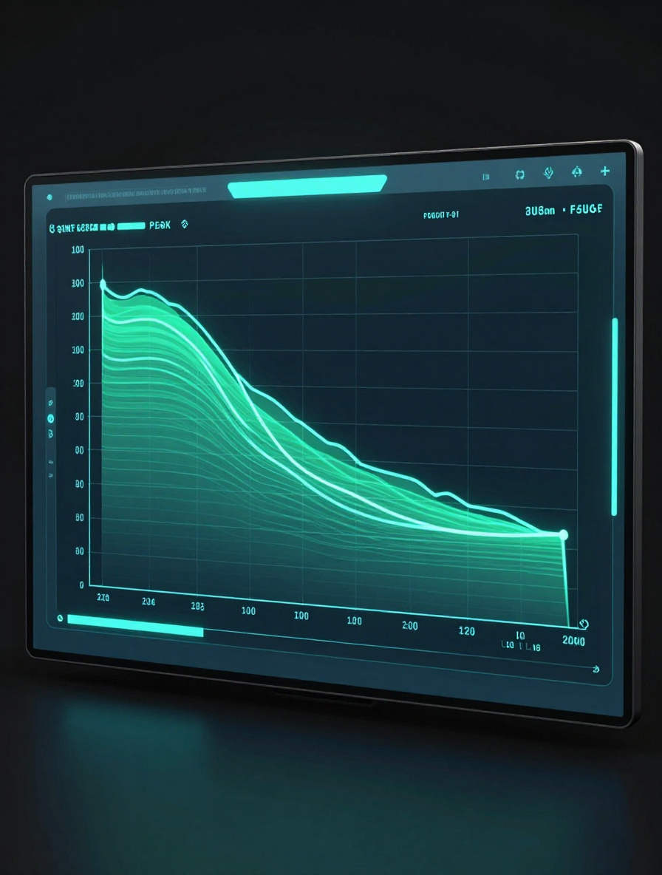
REMAINING USEFUL LIFE
Forecasting Time to Failure
Remaining Useful Life (RUL) estimates how long a component can continue operating before failure. By tracking degradation trends — rising vibration, increasing temperature, growing wear — models project a failure horizon with a confidence interval. Shorter prediction horizons yield higher accuracy; longer horizons enable earlier maintenance planning. Uncertainty bands widen over time, so engineers act when the lower bound of RUL falls within the maintenance planning window, balancing risk against operational continuity.

Slide 15

FROM ALERT TO SAFE ACTION
A Structured Response Workflow
  Validate the signal — rule out sensor noise or false positives. 2. Assess criticality — determine urgency and failure risk. 3. Inspect — perform targeted physical or remote checks. 4. Plan resources — schedule technicians, parts, and downtime. 5. Isolate equipment — safely lock out before intervention. 6. Repair or replace — execute the corrective action. 7. Verify and restore — confirm resolution and resume monitoring.

Slide 16
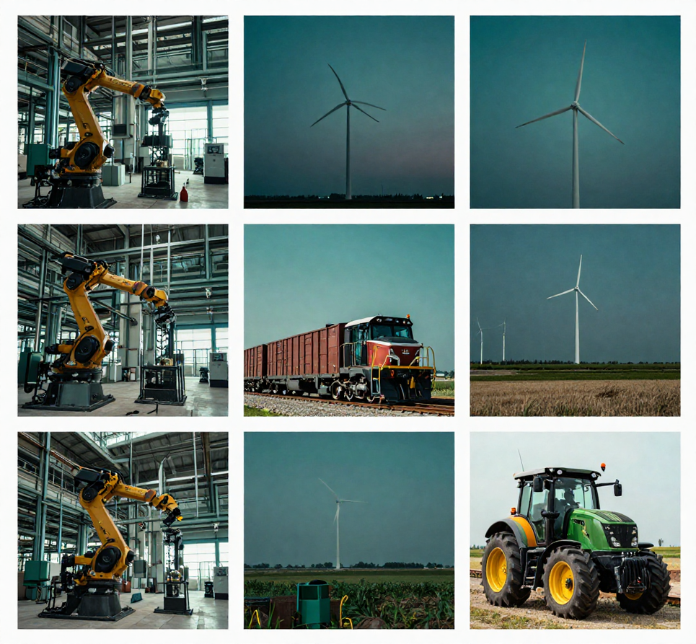
INDUSTRY APPLICATIONS
Predictive Maintenance Across Sectors
Manufacturing: Monitors CNC machines, conveyor belts, and robotic arms to prevent unplanned stoppages on the production floor.
Energy: Detects bearing wear in wind turbines and pump degradation in oil & gas pipelines before failure occurs.
Transport: Tracks engine health, brake wear, and axle vibration in rail fleets and commercial vehicle fleets.
Facilities: Optimises HVAC compressors, elevators, and chillers in smart buildings to cut energy waste.
Agriculture: Monitors tractor drivetrains and irrigation pumps during critical harvest windows to avoid costly downtime.

Slide 17
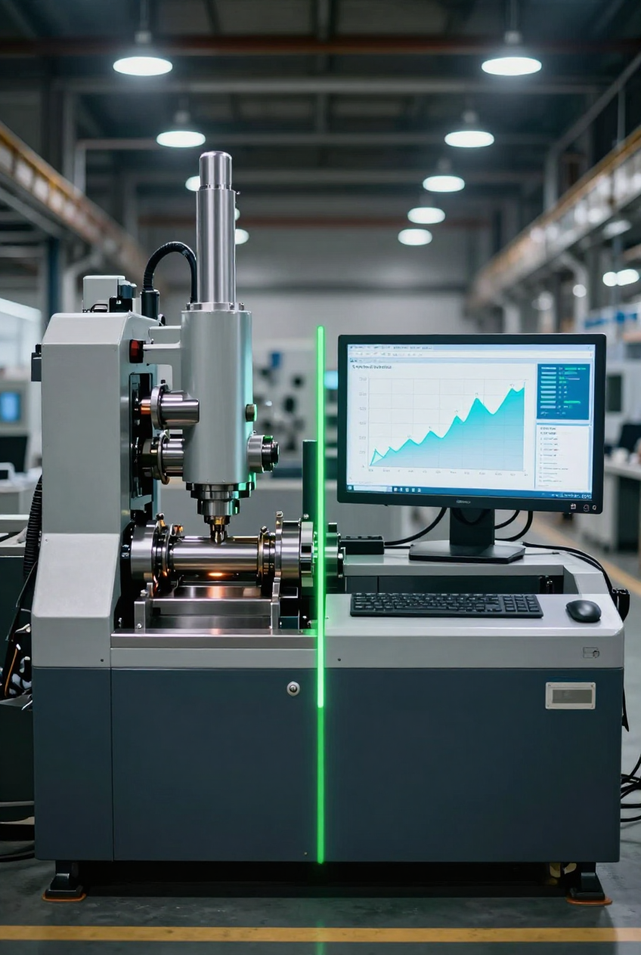
BENEFITS & TRADE-OFFS
Balance Expected Gains Against Practical Constraints
Benefits: Improved equipment reliability and asset lifespan, reduced unplanned downtime, optimized maintenance scheduling, lower spare-parts inventory, and enhanced worker safety. Trade-offs: Upfront sensor and infrastructure costs can be significant; model development requires clean, labeled data and domain expertise; false positives waste resources while false negatives risk failures; integration with legacy systems adds complexity; and ongoing model maintenance demands skilled personnel. Weigh ROI carefully against organizational readiness before scaling deployment.

Slide 18

RISKS & MITIGATION
Identifying Barriers and Controls
Data quality: validate and clean sensor streams. False alarms: tune thresholds and use multi-signal confirmation. Connectivity: deploy edge buffering for resilience. Cybersecurity: encrypt OT/IT traffic and enforce access controls. Integration: use open APIs and middleware adapters. Workforce skills: invest in training and change management. Validation: maintain labelled failure datasets for model audits. Governance: define ownership, escalation paths, and review cycles.

Slide 19

IMPLEMENTATION ROADMAP
From Pilot to Full-Scale Deployment
  Select critical assets — prioritise by failure impact and data availability. 2. Define failure modes — map fault signatures for each asset class. 3. Instrument equipment — install sensors and establish data pipelines. 4. Establish baselines — capture healthy-state signatures. 5. Pilot — validate models on a small asset group. 6. Integrate workflows — connect alerts to CMMS and maintenance teams. 7. Scale — roll out across plant or fleet. 8. Continuously improve — retrain models, refine thresholds, and track KPIs.

Slide 20
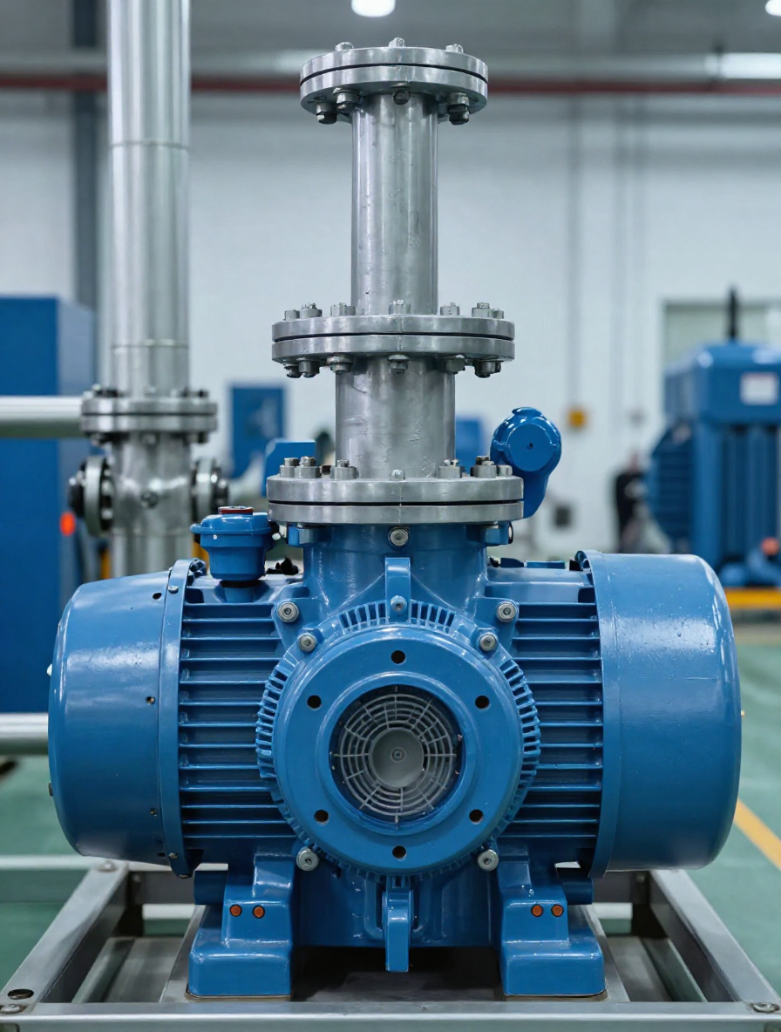
MOTOR & PUMP CASE STUDY
Lessons from the Field
A centrifugal pump motor showed rising vibration (8 mm/s RMS) and bearing temperature (+22°C above baseline) over 3 weeks. Anomaly detection flagged the trend; inspection confirmed early-stage bearing wear. A planned replacement was scheduled during a routine shutdown — avoiding an unplanned failure estimated at 14× the repair cost. Key lessons: early trending beats reactive response, sensor fusion improves confidence, and documented baselines are essential for accurate anomaly detection.

Slide 21
THANKYOU
KPIs: Uptime · MTBF · Cost · Precision
Start with a critical asset, trustworthy data & a safe action workflow.

